Slide 1
COM2501
Scientific Programming
MATLAB - 2
Ankara University
Computer Engineering Department

Slide 2
plot command
To draw a two-dimensional graphic
plot(x, y)
    x: Vector containing values for the x-axis
    y: Vector containing values for the y-axis

Slide 3
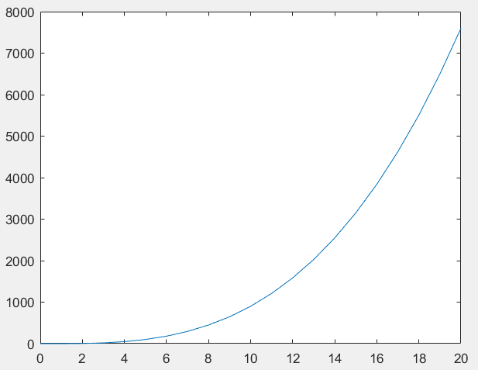
plot command
y = x³-x²
0 ≤ x ≤ 20
x=0:1:20;
y=x.^3-x.^2;
plot(x,y)

Slide 4
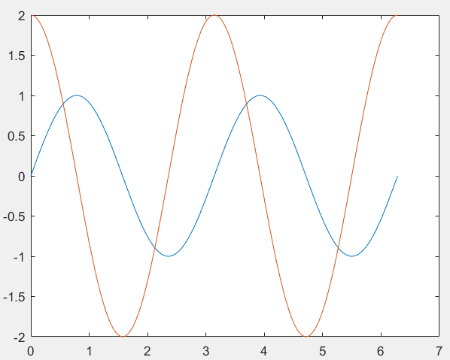
plot command
y1 = sin 2x
y2 = 2 cos 2x
0 ≤ x ≤ 2π
x = 0:pi/20:2*pi;
y1 = sin(2*x);
y2 = 2*cos(2*x);
plot(x, y1, x, y2)

Slide 5
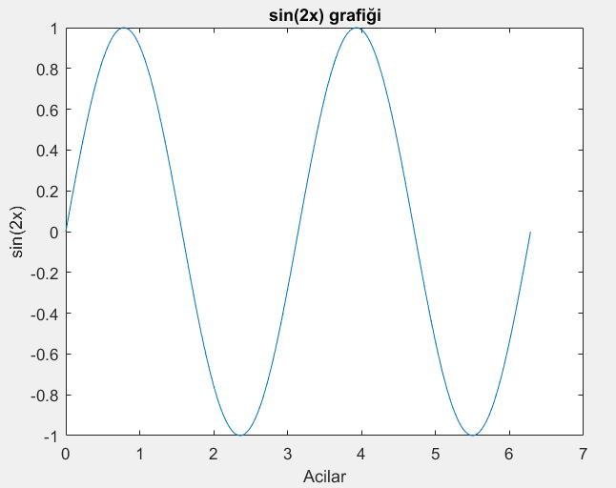
Naming
title(‘Title of the Chart’)
xlabel(‘label of the x-axis’)
ylabel(‘label of the y-axis’)
x = 0:pi/20:2*pi;
y = sin(2*x);
plot(x,y)
title('sin(2x) chart');
xlabel('Acilar');
ylabel('sin(2x)');

Slide 6
Line / Pointer Style
plot(x,y,c)
  x: Vector containing values for the x-axis
  y: Vector containing values for the x-axis
  c: line style coding
Line style | Description
- | Straight line
- - | Dashed line
: | Two dotted line
-. | Dashed dotted line

Slide 7
Line / Pointer Style
plot(x,y,c)
Style | Definition | Style | Definition
'o' | Circle | 'd' | Diamond
'+' | Plus sign | '^' | Upward-facing triangle
'*' | Star | 'v' | Downward-facing triangle
'.' | Dot | '>' | Right-facing triangle
'x' | x | '<' | Left-facing triangle
'_' | Horizontal line | 'p' | Pentagon
'|' | Vertical line | 'h' | Hexagon
's' | Square

Slide 8
Line / Pointer Style
plot(x,y,c)
Letter | Color
y | Yellow
m | Magenta
c | Cyan
r | Red
g | Green
b | Blue
w | White
k | Black

Slide 9
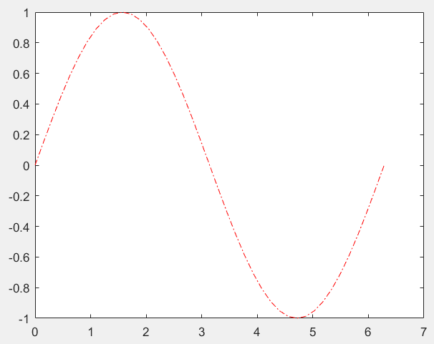
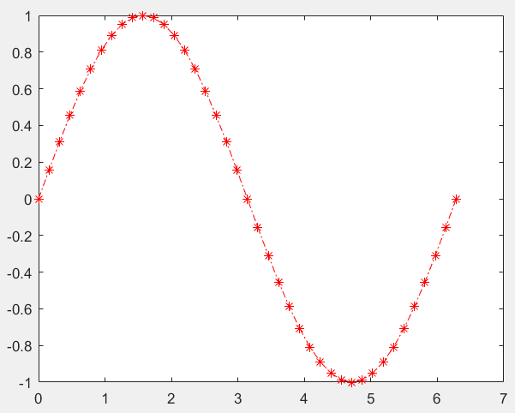
Line / Pointer Style
x = 0:pi/20:2*pi;
plot(x,sin(x),'-.r')
x = 0:pi/20:2*pi;
plot(x,sin(x),‘-.r*')

Slide 10
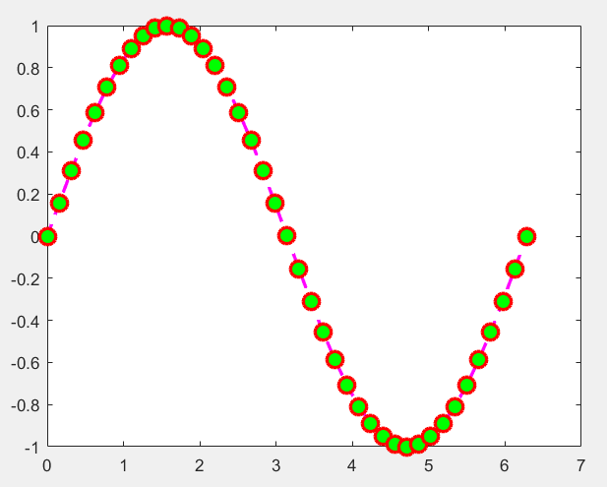
Line / Pointer Style
plot(x,sin(x), 'LineStyle','--',...
      'Color','m',...
      'LineWidth', 2,...
      'Marker','o',...
      'MarkerEdgeColor','r',...
      'MarkerFaceColor','g',...
      'MarkerSize',10)

Slide 11
Line / Pointer Style
To draw multiple graphics with different properties in a single window
plot(x₁,y₁,s₁, x₂,y₂,s₂, …, x_{n},y_{n},c_{n})

Slide 12
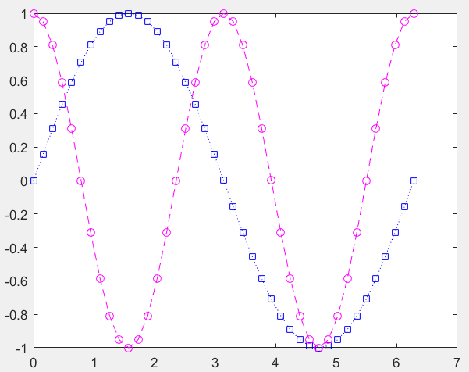
Multi graphics
x = 0:pi/20:2*pi;
plot(x,sin(x),':bs',x,cos(2*x),'--mo')

Slide 13
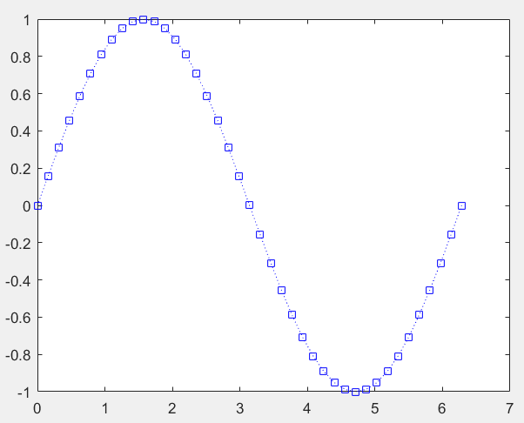
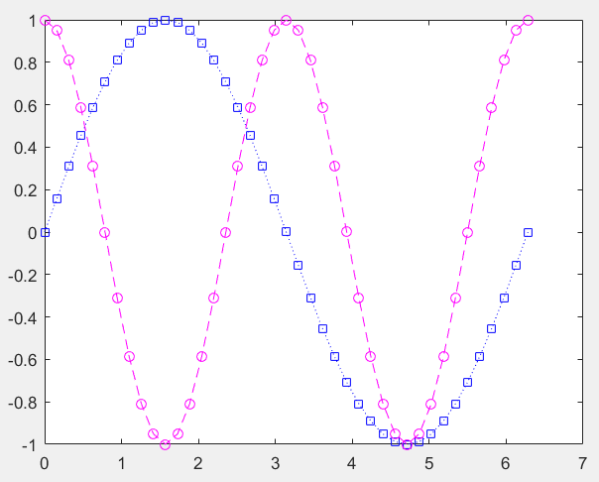
Multi graphics
x = 0:pi/20:2*pi;
plot(x,sin(x),':bs‘)
hold on
plot(x,cos(2*x),'--mo')

Slide 14
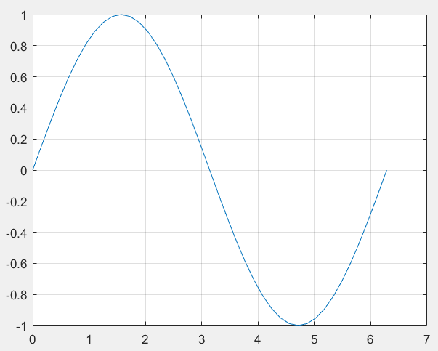
Grid on / Grid off
x = 0:pi/20:2*pi;
plot(x,sin(x))
grid on

Slide 15
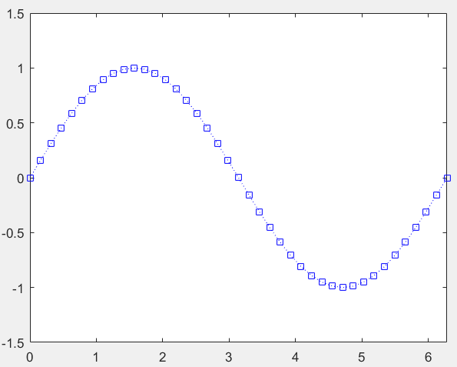
Scaling Axis
axis ( [x_{min} x_{max} y_{min} y_{max}] )
x = 0:pi/20:2*pi;
plot(x,sin(x))
axis([0 2*pi -1.5 1.5])

Slide 16
Functions in Matlab
Functions are m-files.
The first line should contain the definition of the function.
function [output1, output2, ...] = function-name (input1, input2, ...)
The name of the function and the name of the file with m extension must be the same.

Slide 17
Functions in Matlab
sprintf("The maximum number: %d\n", function1(4, 3, 5));
function max=function1(x, y, z)
max = x;
if y > max
max = y;
end
if z > max
max = z;
end

Slide 18
Functions in Matlab
Function that returns the largest number in a matrix and its index.
A= [4 2 1; 3 6 5]
[m i j]=function2(A)
B=[1 1; 2 2;4 4; 5 3]
[m i j]=function2(B)
function [max, r, c]=function2(X)
[m n]=size(X);
max=X(1,1);
r=1;
c=1;
for i=1:m
for j=1:n
if X(i,j)>max
max=X(i,j);
r=i;
c=j;
end
end
end

Slide 19
Functions in Matlab
The function that prints the value it takes as an argument on the screen.
function3(3)
function function3(a)
disp(a);

Slide 20
Functions in Matlab
The function that calculates and returns the sum of numbers up to 10.
disp(function4)
function f=function4
f=0;
for i=1:10
f=f+i;
end

